Slide 1
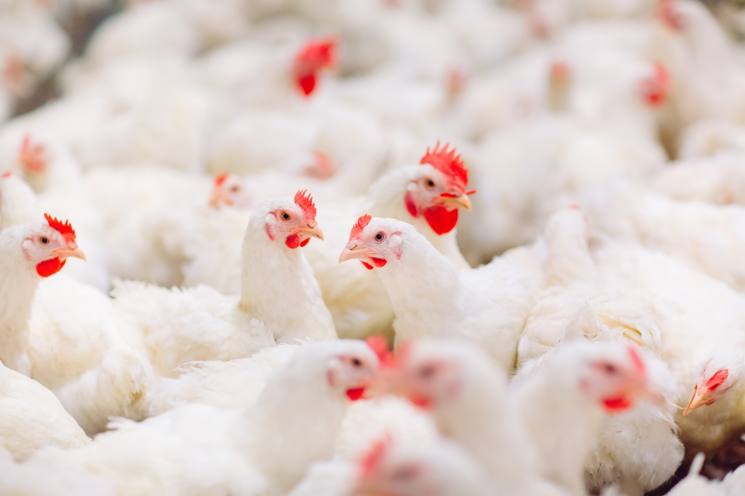

G2-IOT TASIN
Smart IoT-Based Monitoring System in Poultry Farms
Using Chicken Behavioral Analysis
GET STARTED

Slide 2
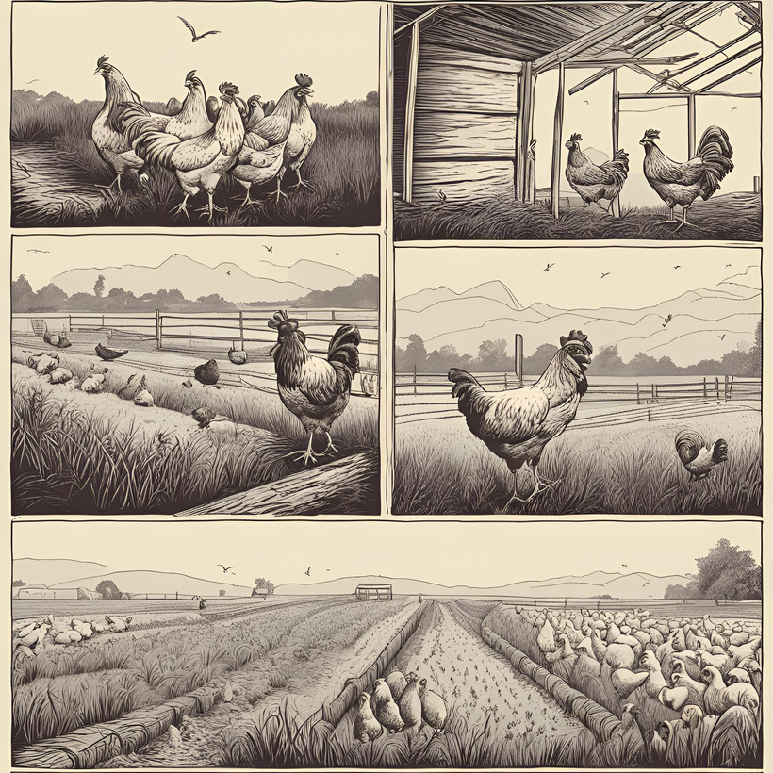
PROBLEM STATEMENT
1.
Economic losses in poultry farming due to diseases and poor management.
2.
Rapid disease spread within chicken flocks.
3.
Difficulty in manually monitoring chicken behaviors like preening and dustbathing.
4.
Need for real-time, automated health monitoring systems.

Slide 3

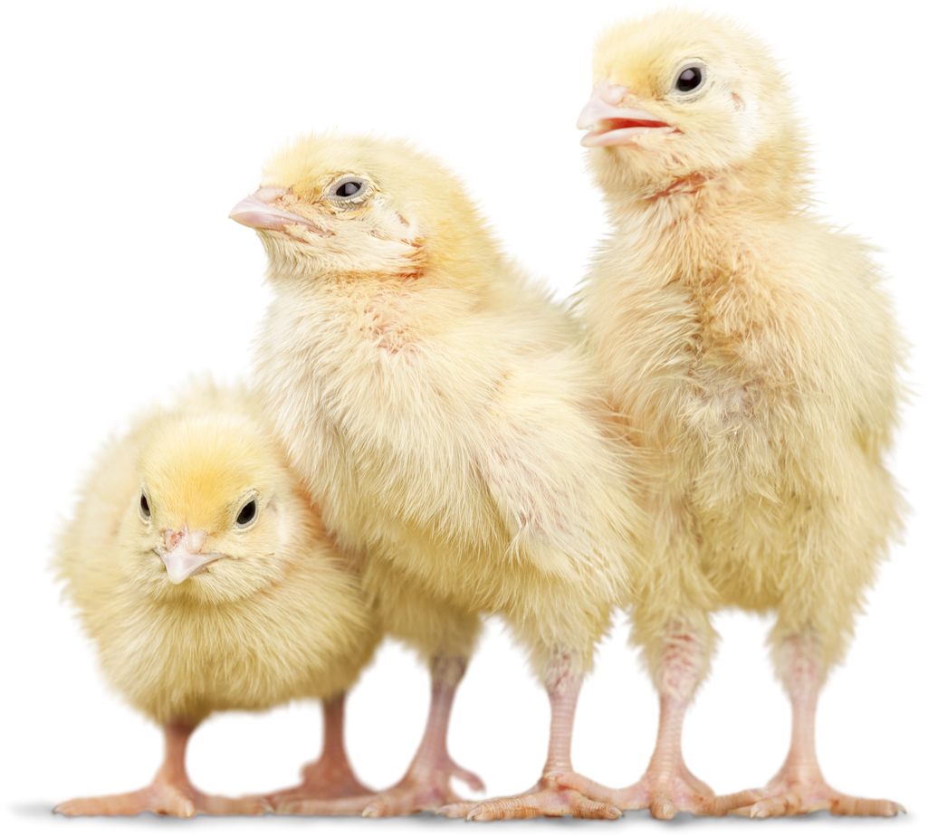
PROPOSED SOLUTION
A Smart Poultry Monitoring System (SPMS) using IoT sensors.
Tracks chicken behaviors (e.g., pecking, preening, dustbathing).
Uses machine learning to analyze behavior data.
Detects abnormal behaviors indicating health issues.

Slide 4
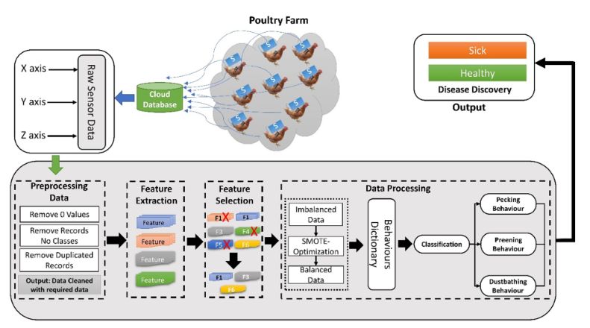
SYSTEM WORKFLOW
DATA COLLECTION:
DATA IMBALANCE HANDLING:
• Sensors track chicken movements (X, Y, Z axes).
• Uses SMOTE and AHA to balance rare behaviors.
PREPROCESSING:
BEHAVIOR CLASSIFICATION:
• Cleans and organizes raw data.
• Machine learning models classify behaviors.
FEATURE EXTRACTION:
DISEASE DETECTION:
• Extracts metrics like movement variation, acceleration.
• Identifies health issues from behavior patterns.

Slide 5
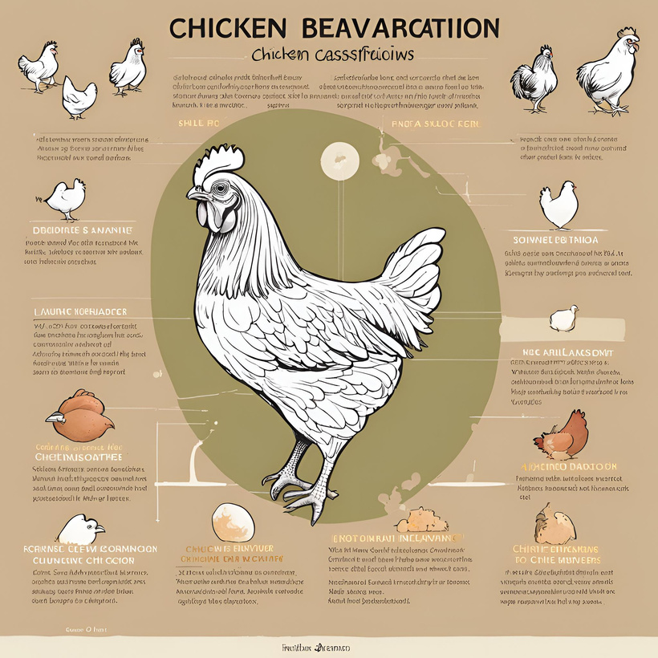
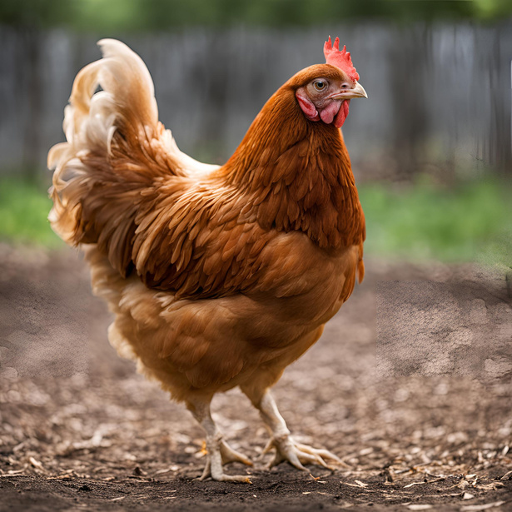
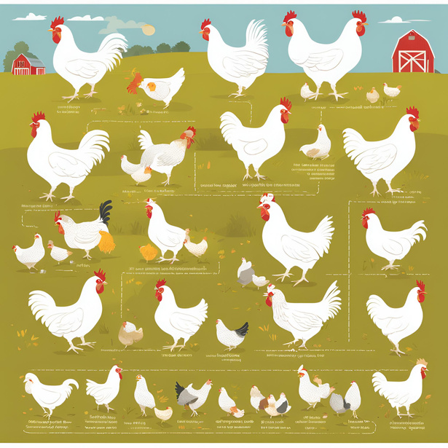
KEY RESULTS
Behavior Classification:
• Random Forest achieved 98% accuracy.
• Successfully classified behaviors (pecking, preening, dustbathing).
Disease Detection:
• Differentiated healthy vs. sick chickens based on behavior.
Data Imbalance Handling:
• SMOTE-AHA improved accuracy significantly.

Slide 6
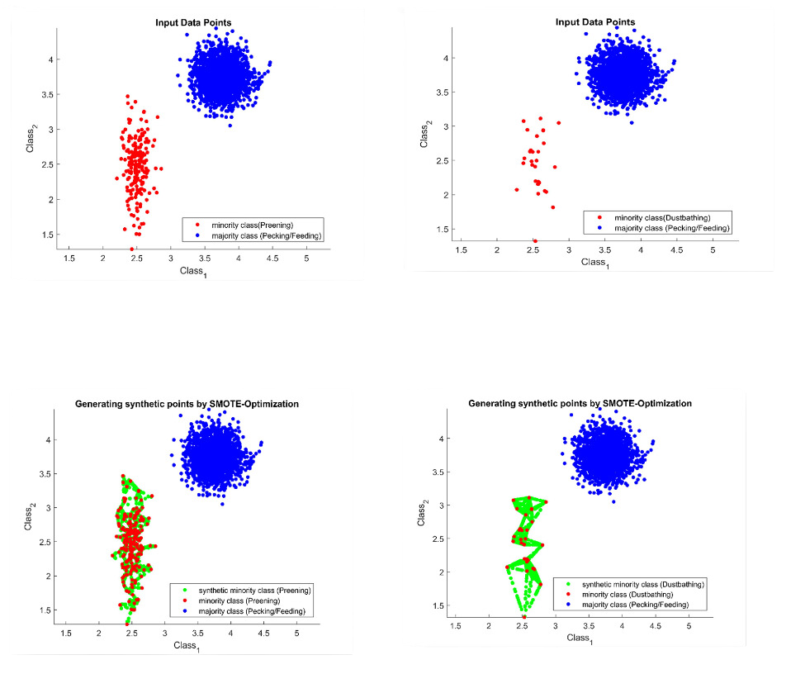
SIGNIFICANCE
Real-Time Monitoring:
Continuous tracking of poultry behavior using IoT sensors.
Improved Disease Management:
Early detection of diseases reduces losses.
Higher Accuracy:
Advanced algorithms ensure reliable predictions.

Slide 7
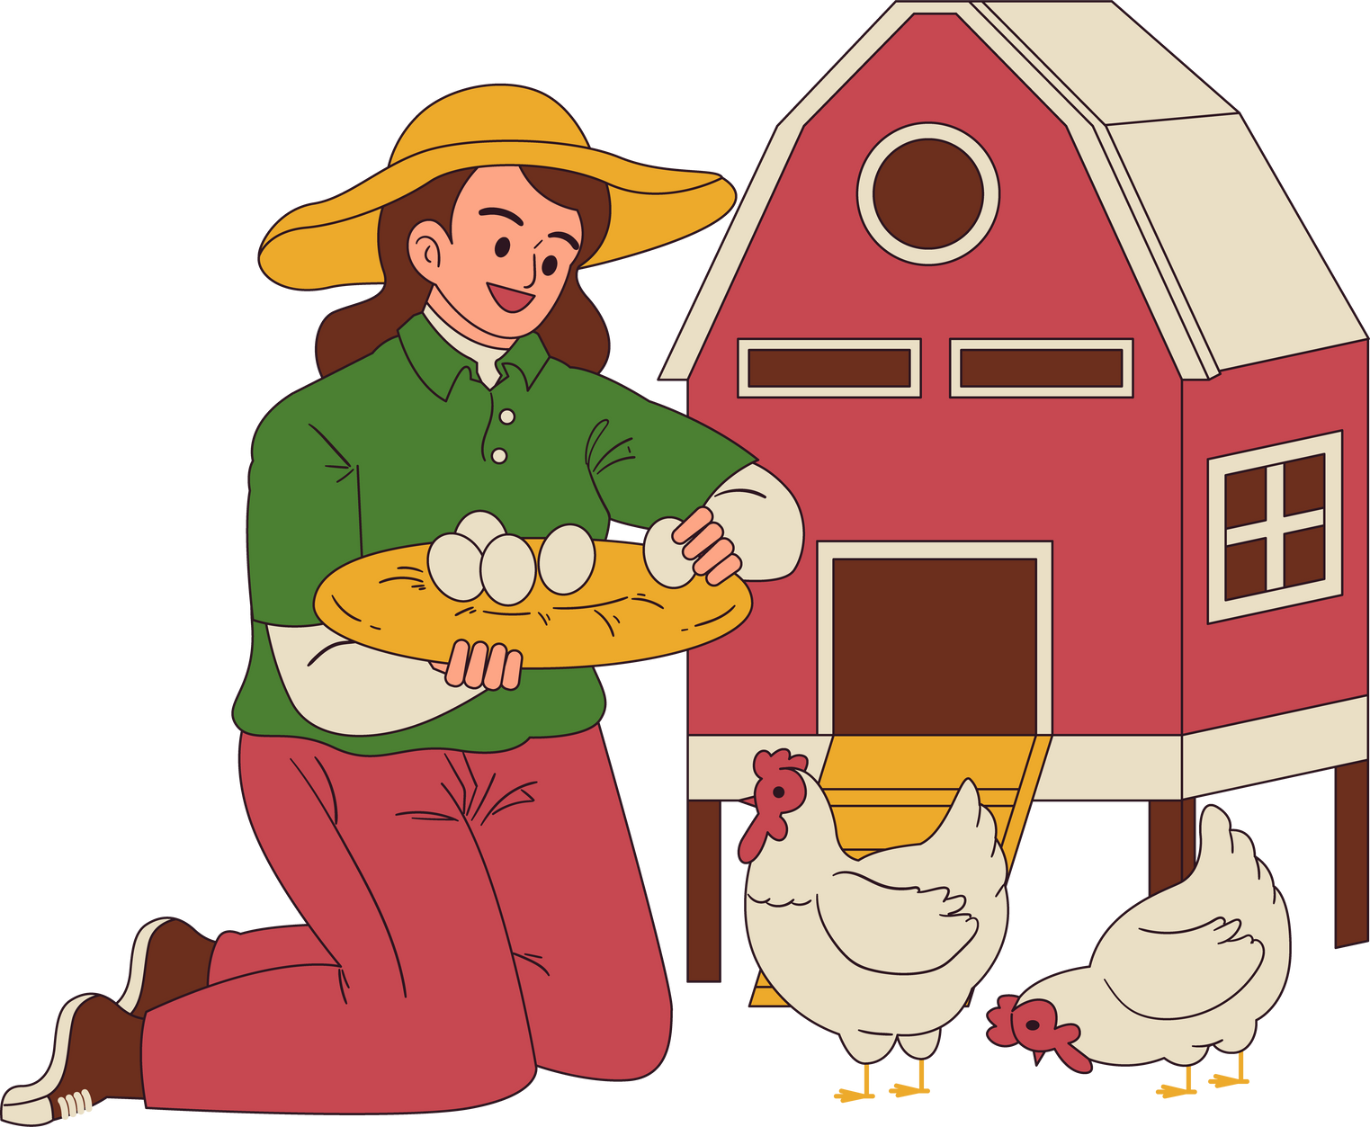
FUTURE WORK
• Extend the system to handle multi-class imbalanced
datasets.
• Incorporate additional behaviors for better diagnostics.
• Explore more advanced IoT devices for data collection.

Slide 8

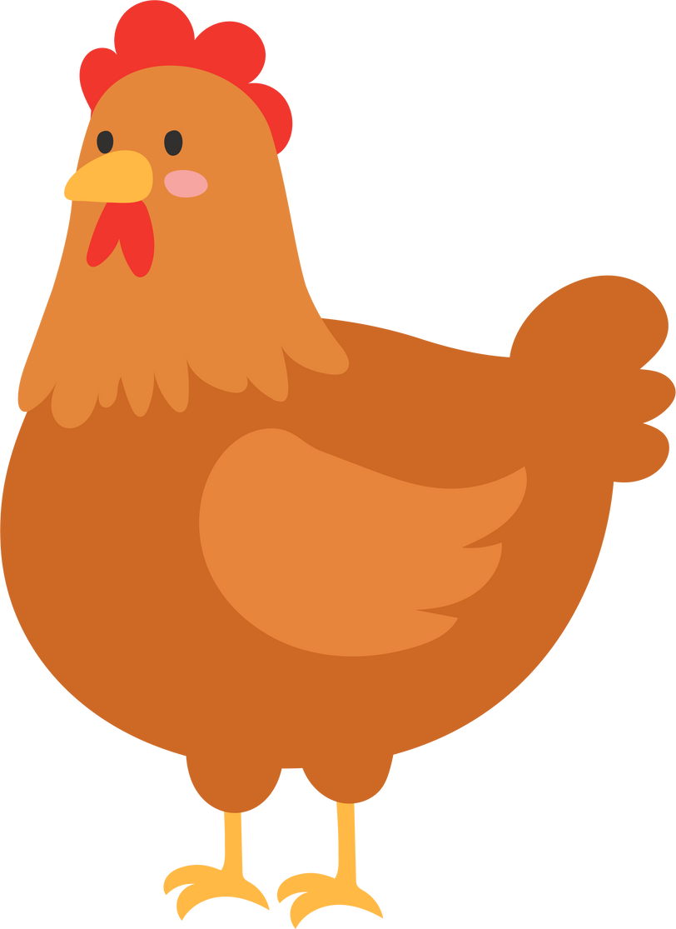
LET’S TALK ABOUT THE LIMITATIONS
IMBALANCED DATA ISSUES:
SMOTE may introduce noise near class boundaries, complicating behavior classification.
SENSOR DEPENDENCY:
Reliance on wearable sensors can be costly and challenging to deploy on a large scale.
RARE BEHAVIOR CLASSIFICATION:
Behaviors like dustbathing remain difficult to classify accurately despite oversampling.
LIMITED DISEASE DETECTION:
Focuses only on behavior-based health analysis without identifying specific diseases or pathogens.

Slide 9




MEET OUR TEAM
Tanvir-ul Islam Tasin
Junayed Al Habib
Mahmudul Shovon
Talha Jubayer

Slide 10
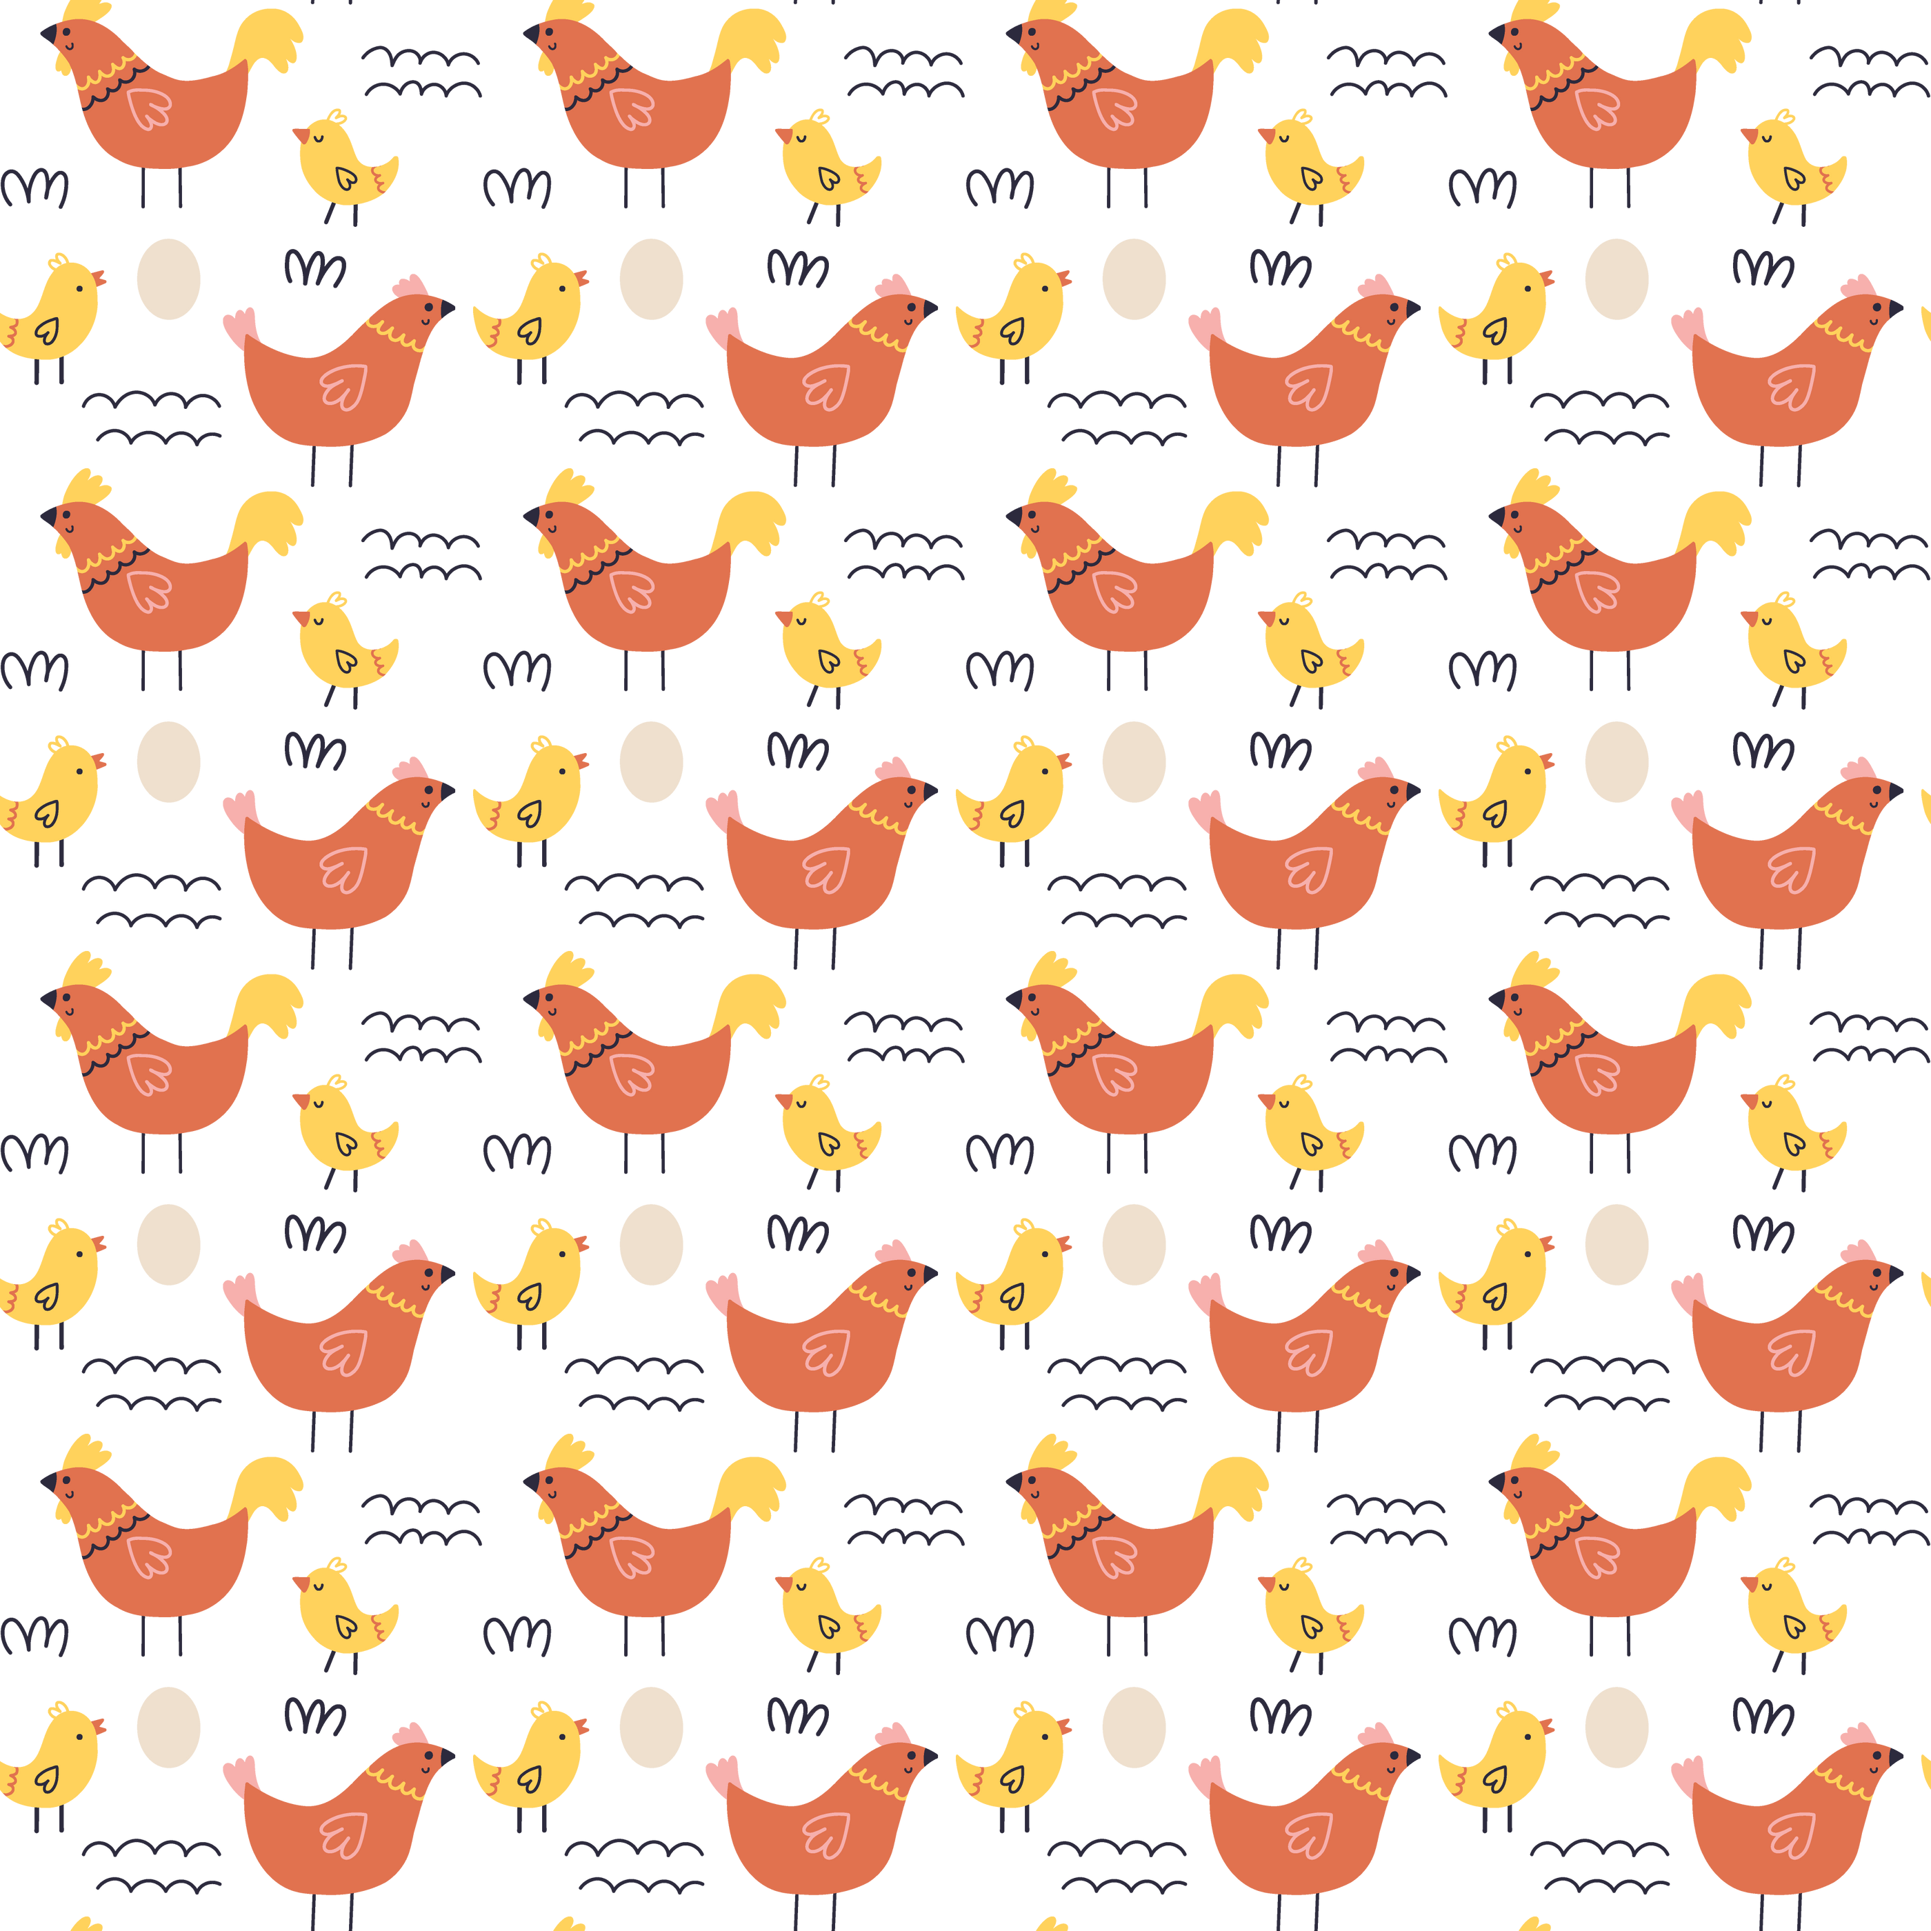

THANK YOU
G2-IOT TASIN

